Slide 1
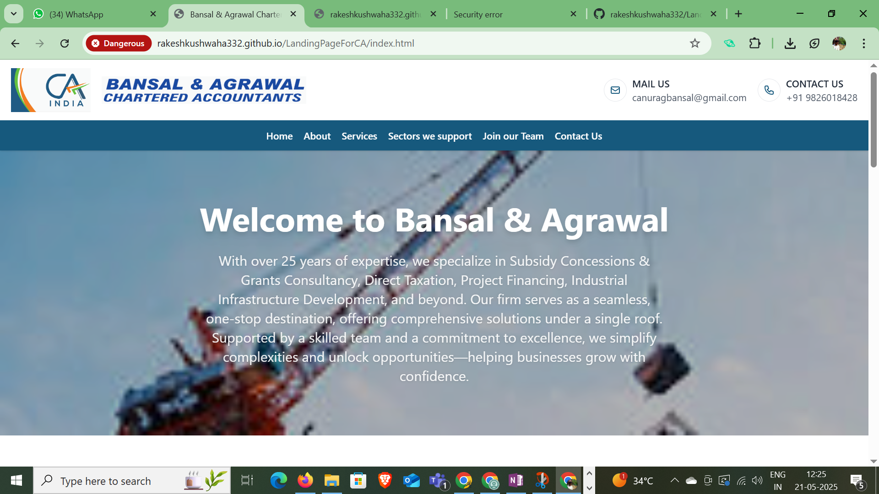

ORIGINAL
Changes Required
The content welcome………….. Should be in bottom like in the refrence image

Slide 2
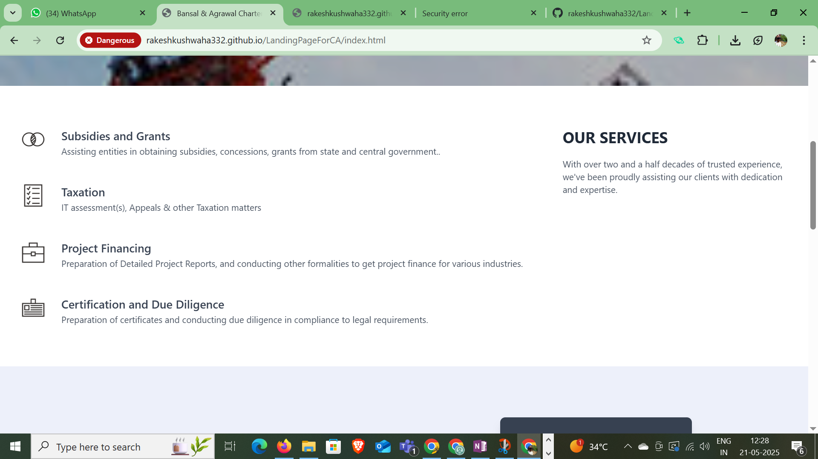
ORIGINAL
Changes Required
Certificate and due delligence not required

Slide 3
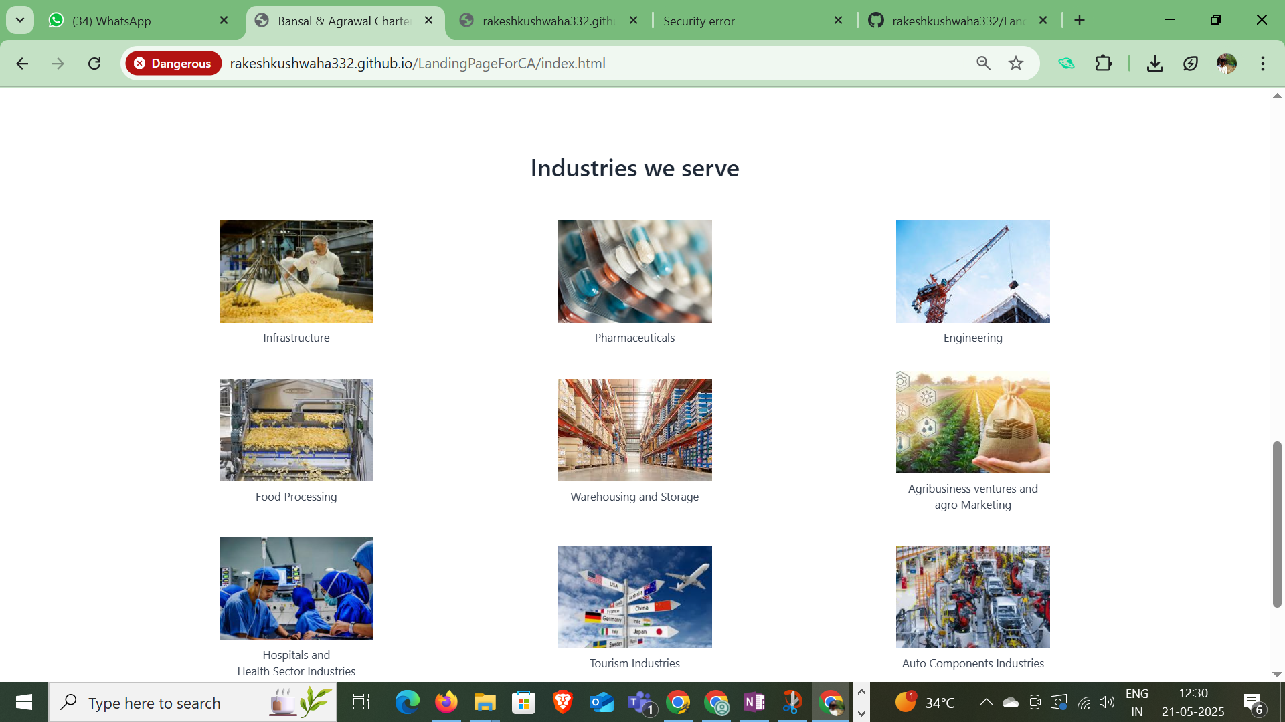
Infrastrucutre, pharmacuticals and engineering not required. - Only 6 is sufficient

Slide 4
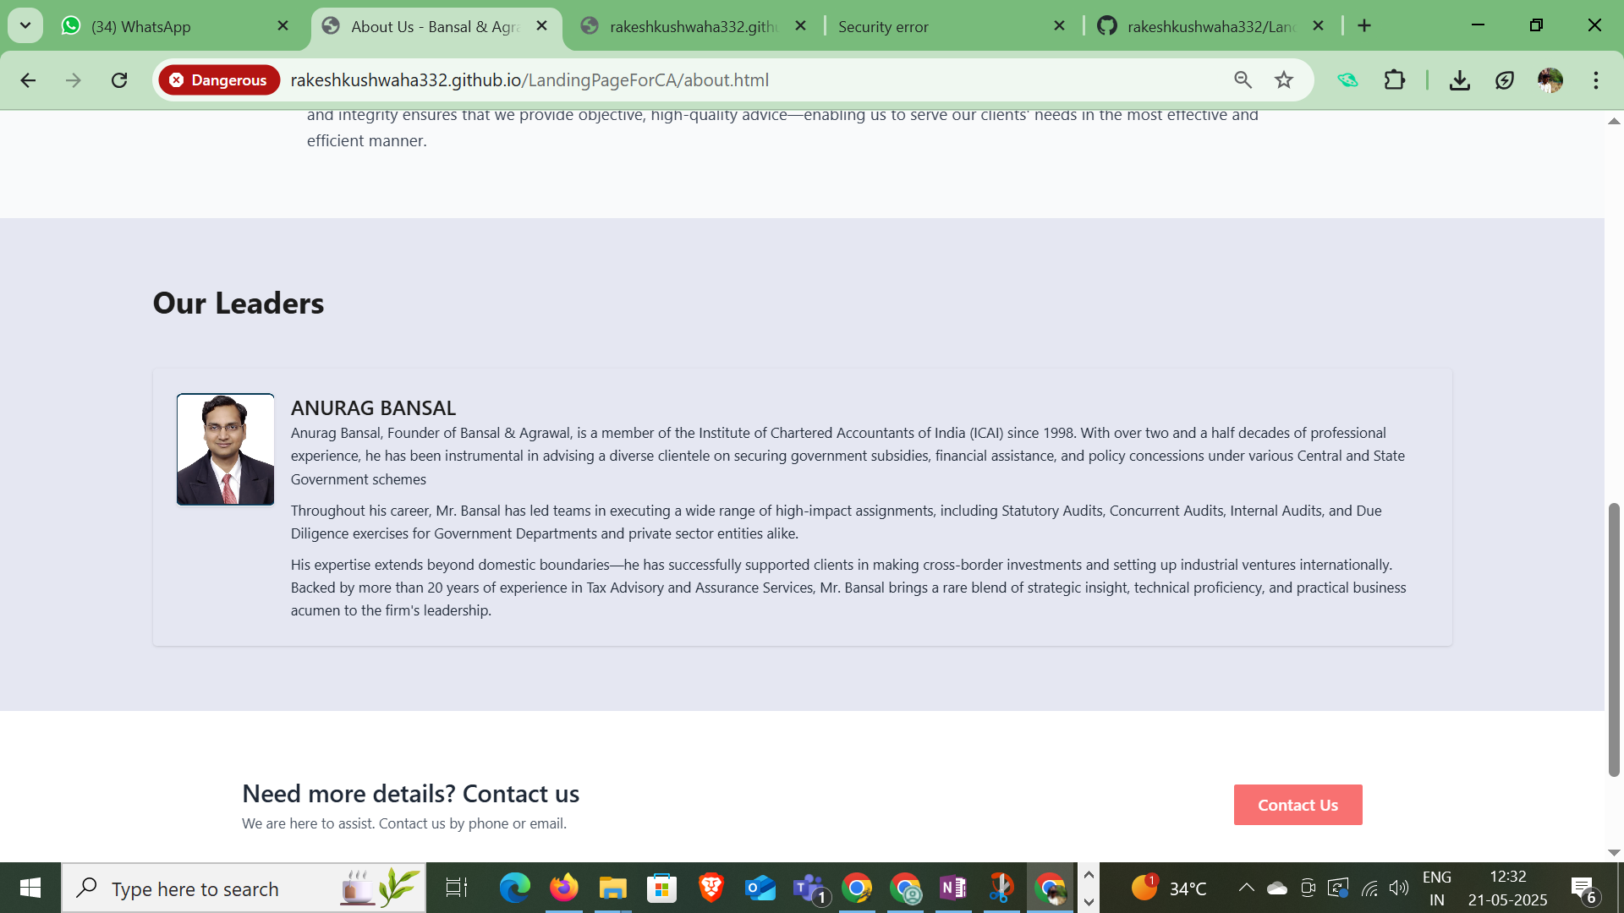
Our Leader

Slide 5
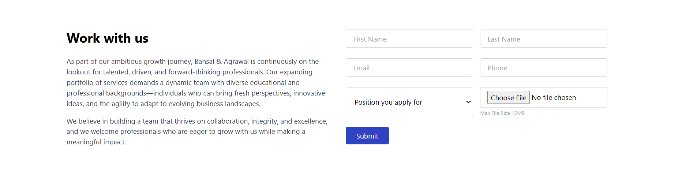
Put google form here:
- Create google form with the following Questions and then link it here.

Slide 6
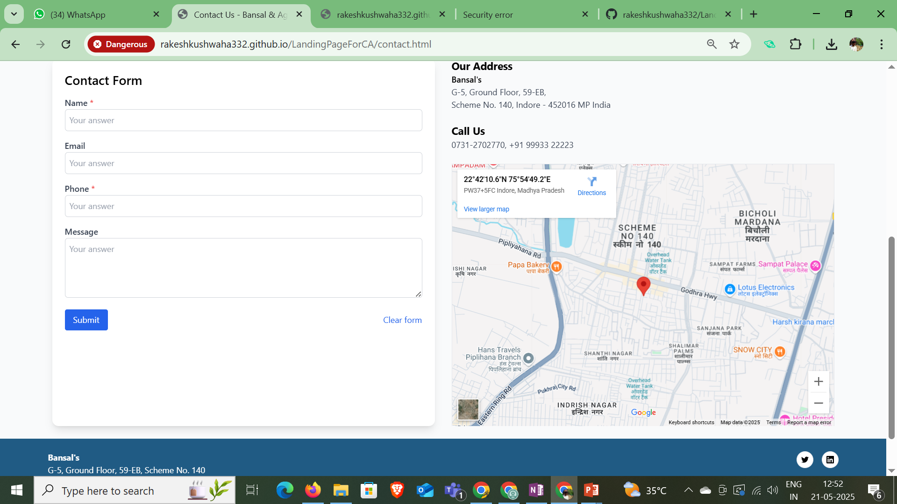
Put google form here:
- Create google form with the following Questions and then link it here.

Slide 7
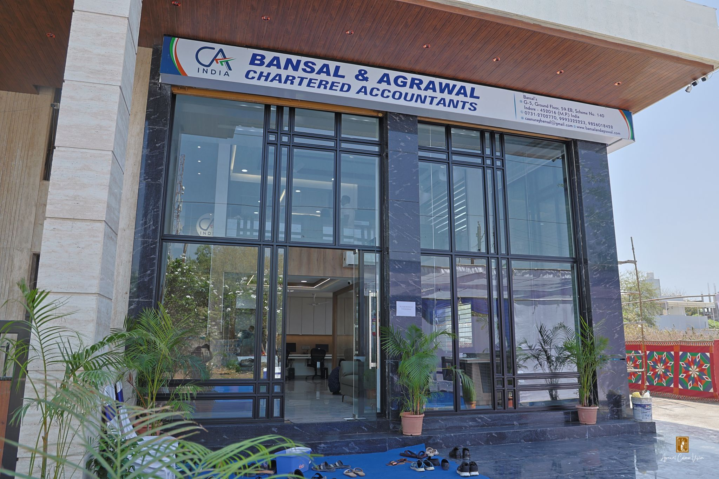
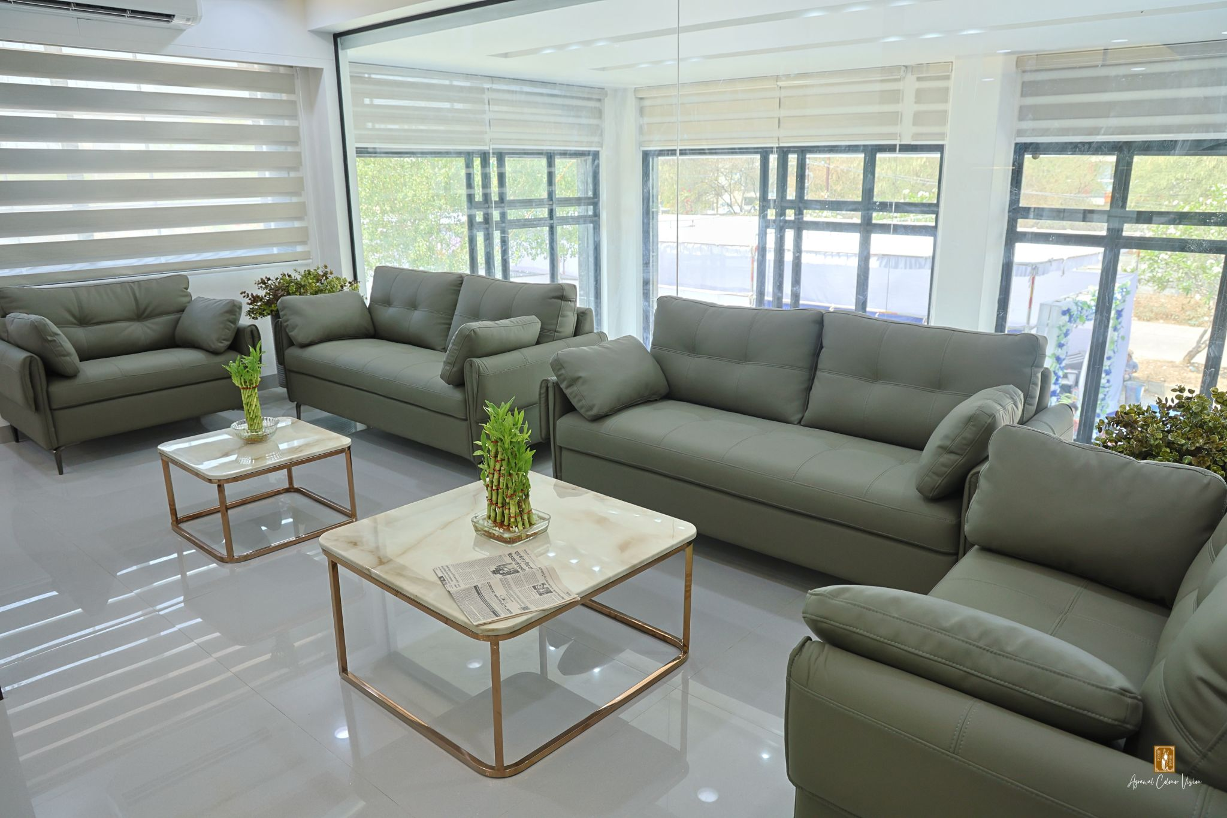
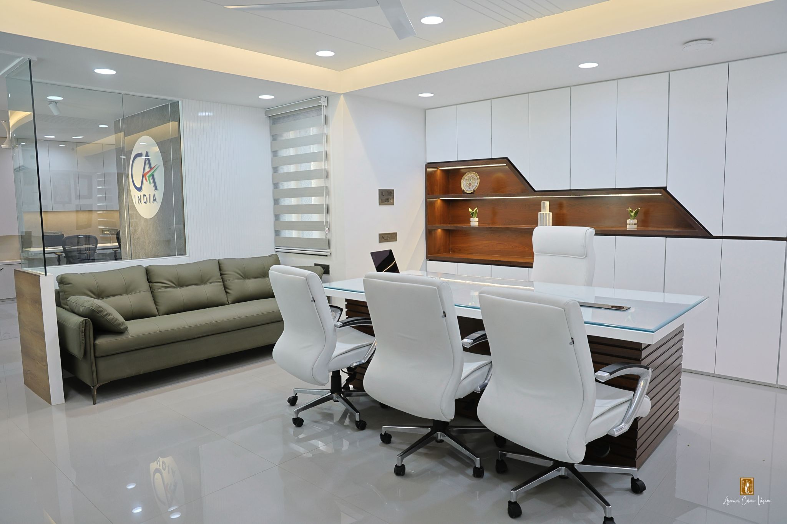

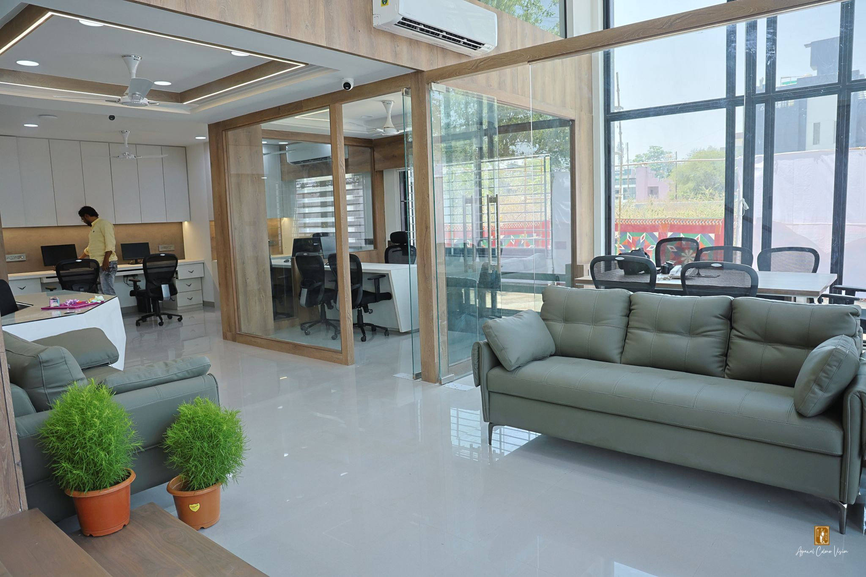
PUT This 5 images in sliding banner

Slide 8
Important:
1- Header and foother of the website is not same
2- the header has extra margin and padding compare with bansalandagrawal.com

